Slide 1
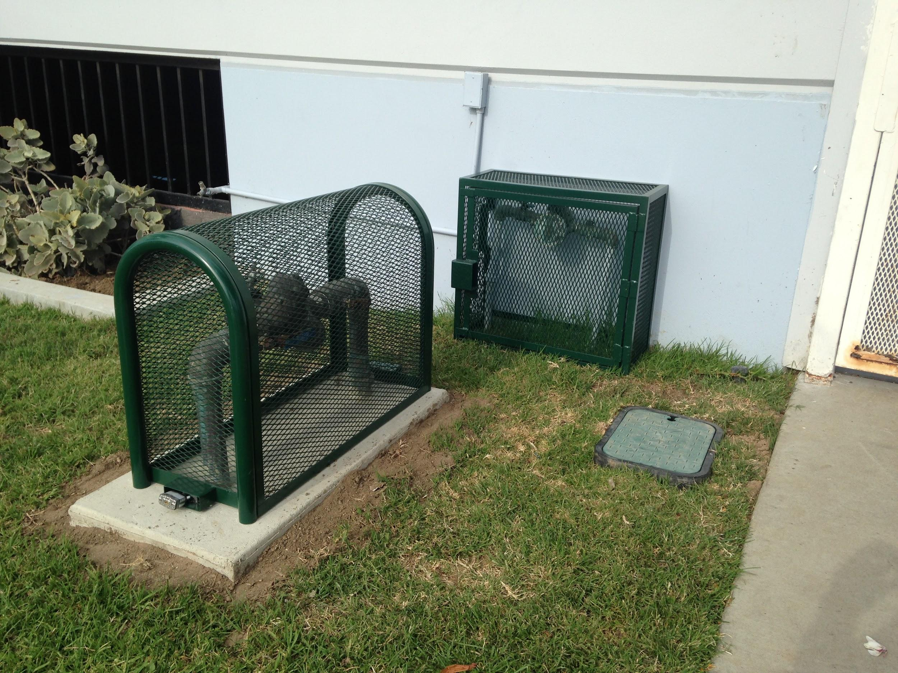
Installing a
Backflow Cage

Slide 2
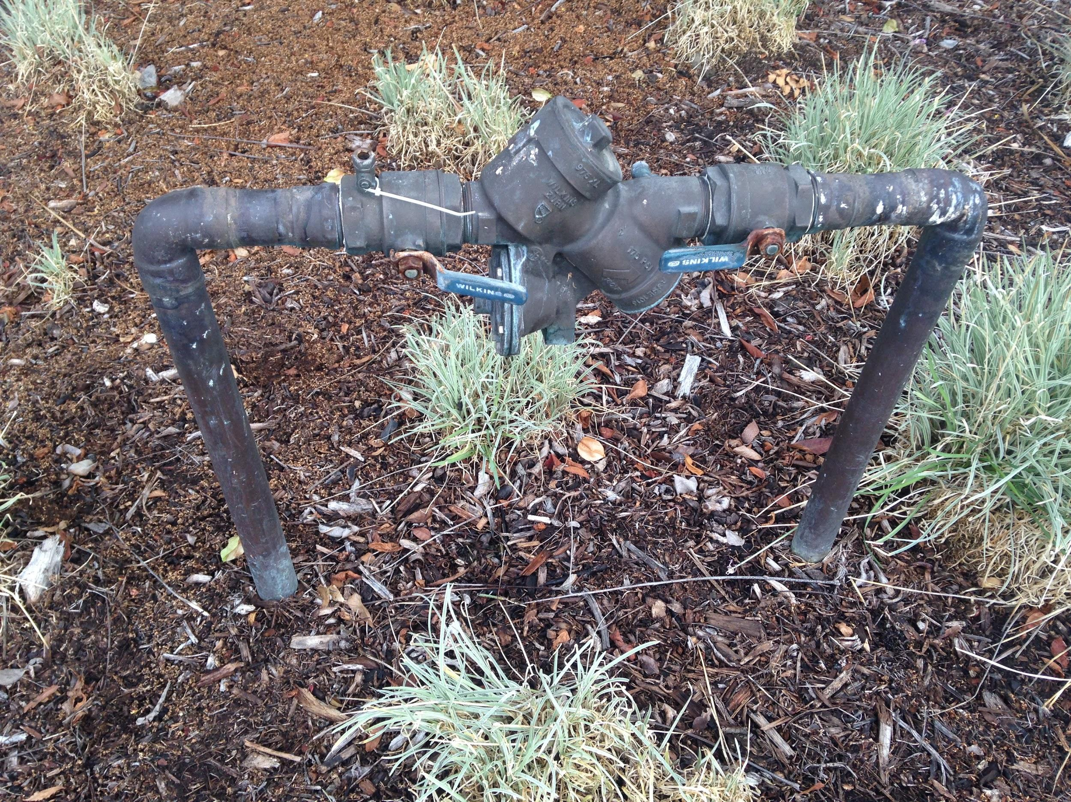
Verify the Backflow and Area

Slide 3
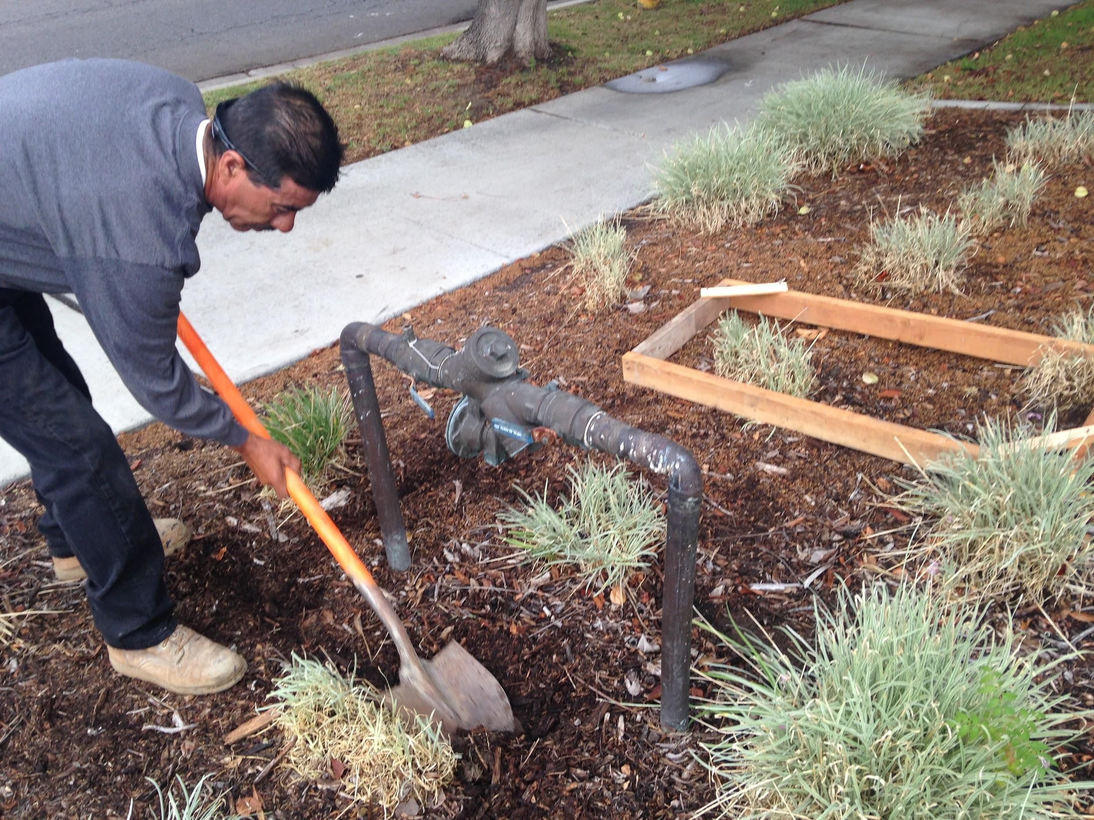
Prepare and Clean Area around the backflow for the Form.

Slide 4
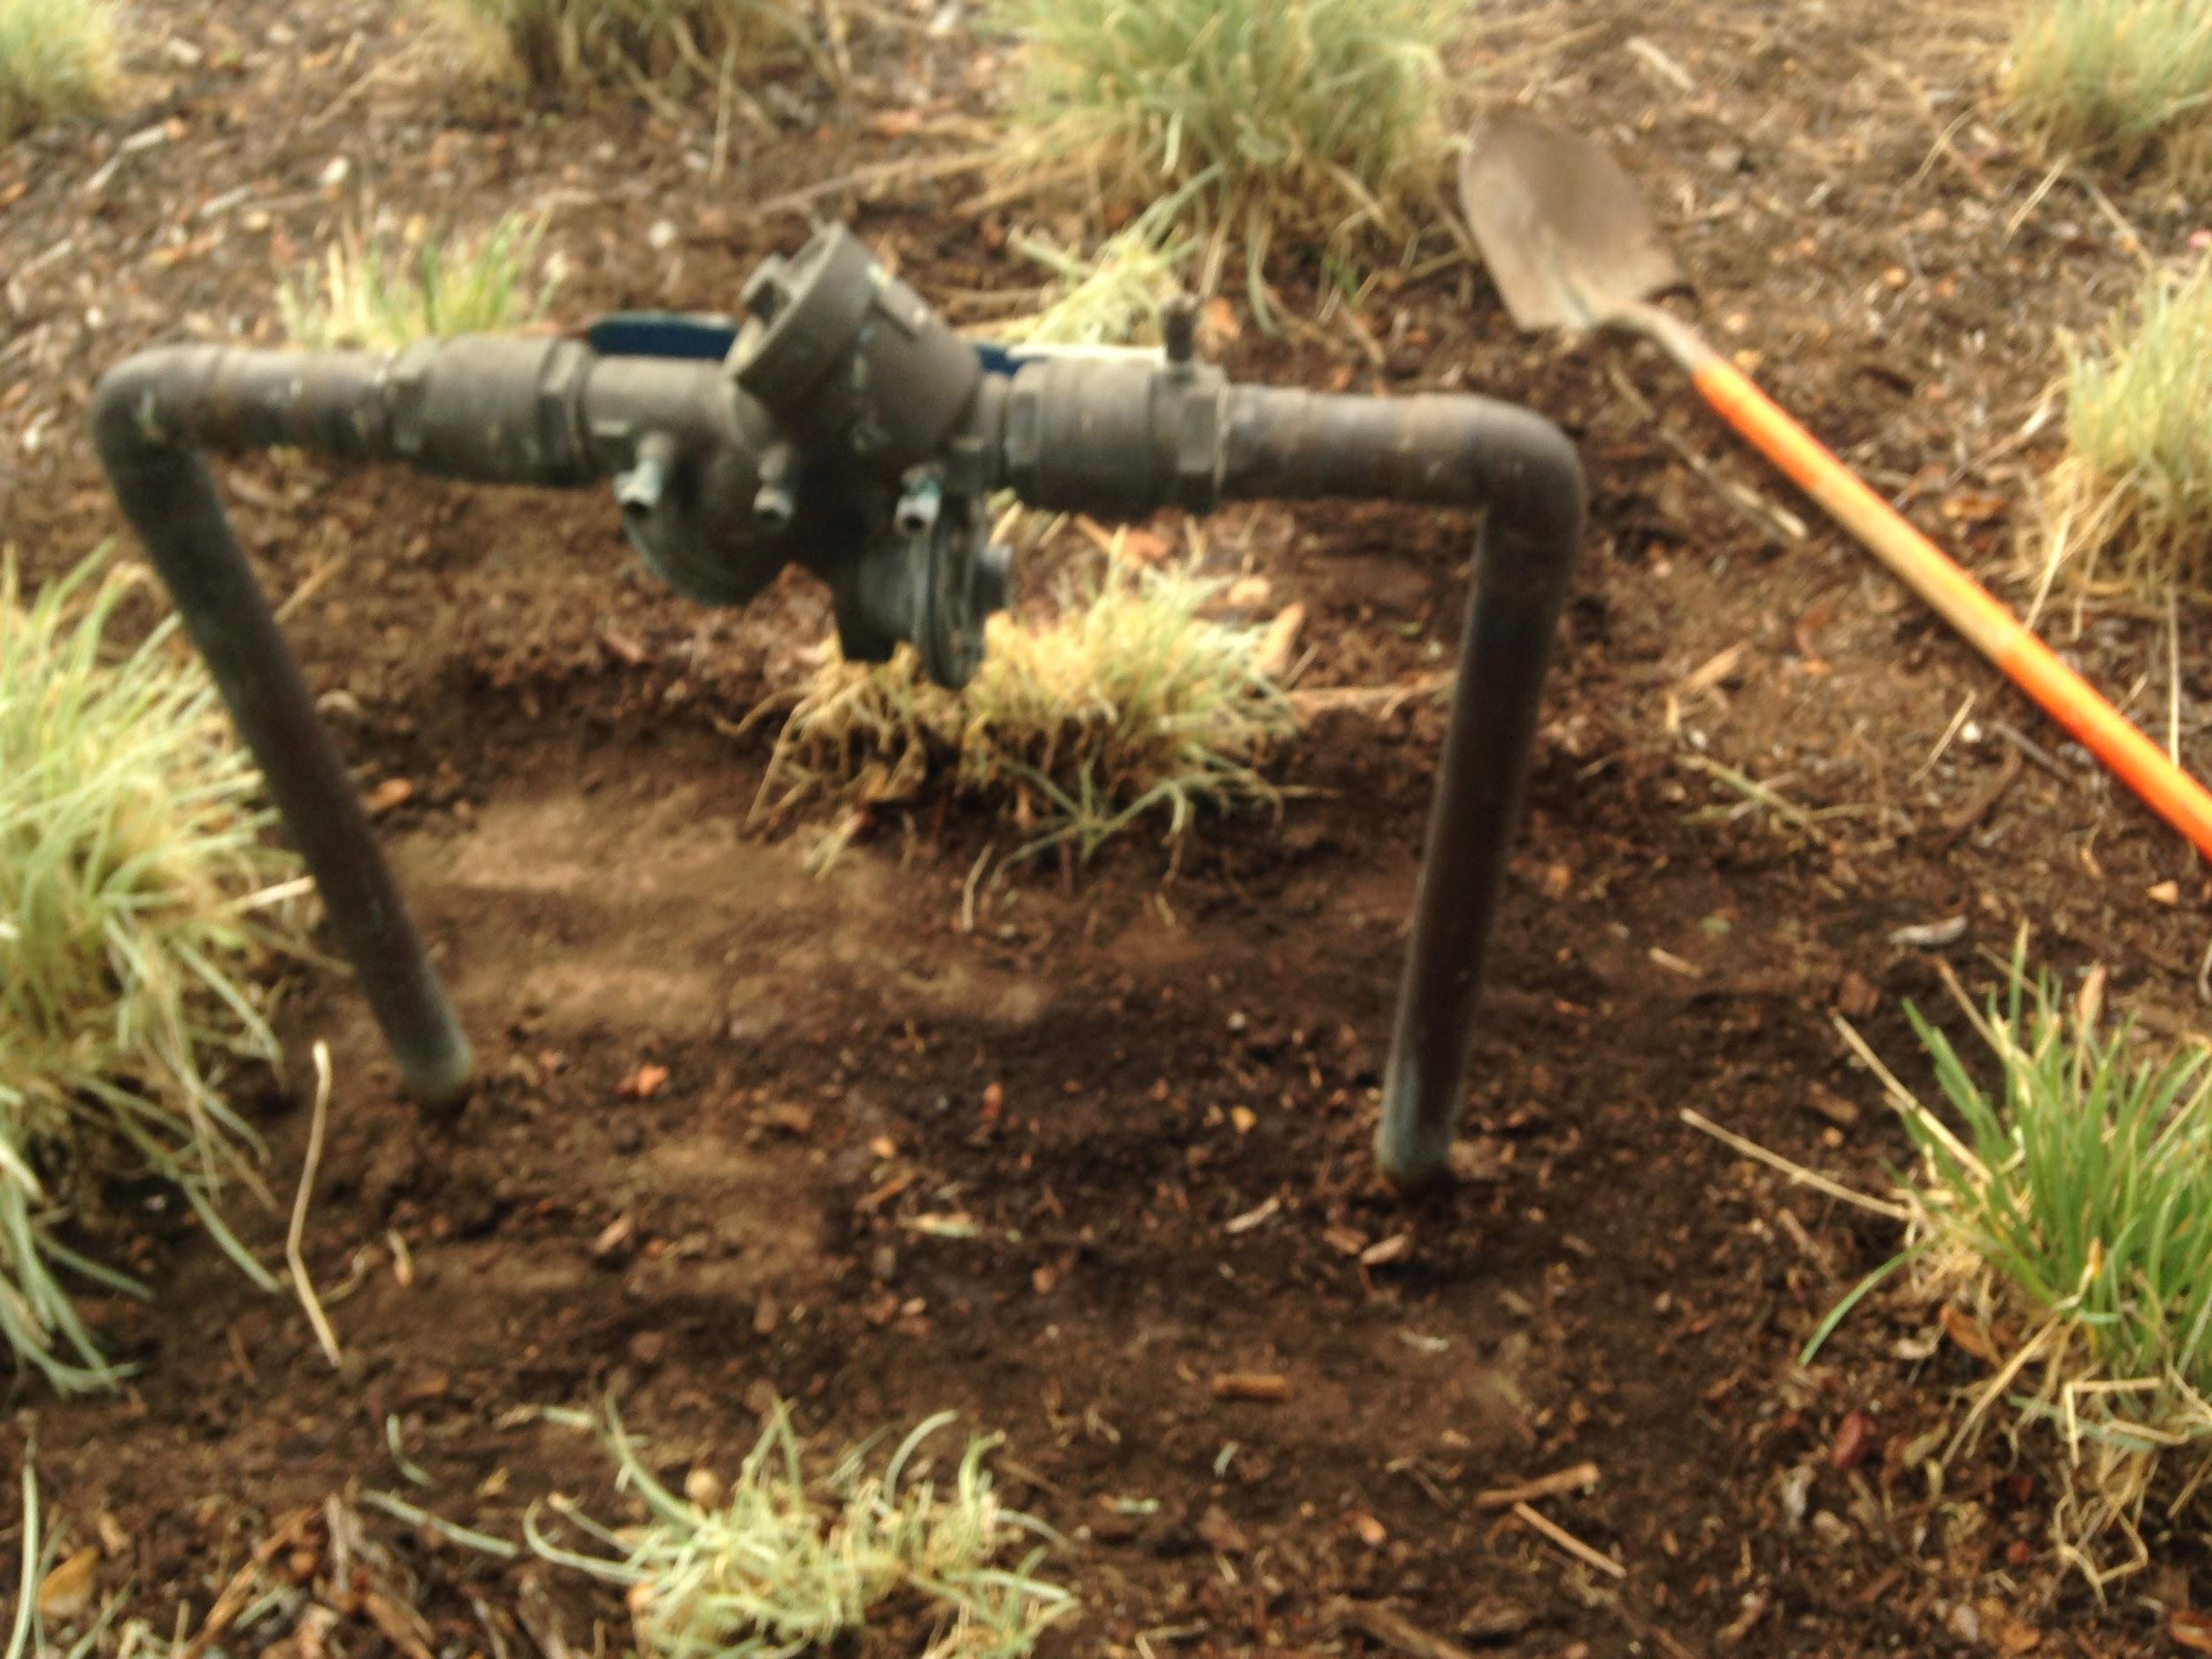
Have area prepared for form.

Slide 5
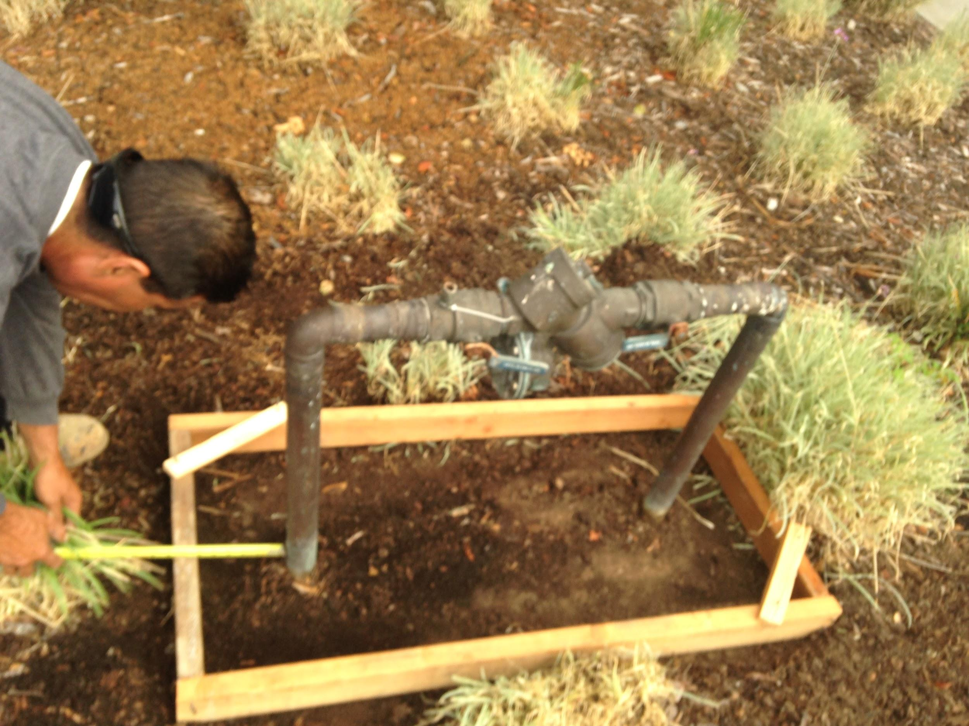
Place form and Square. Put pipe insulation and use plumber’s tape on the insulation to protect pipes from cement.

Slide 6
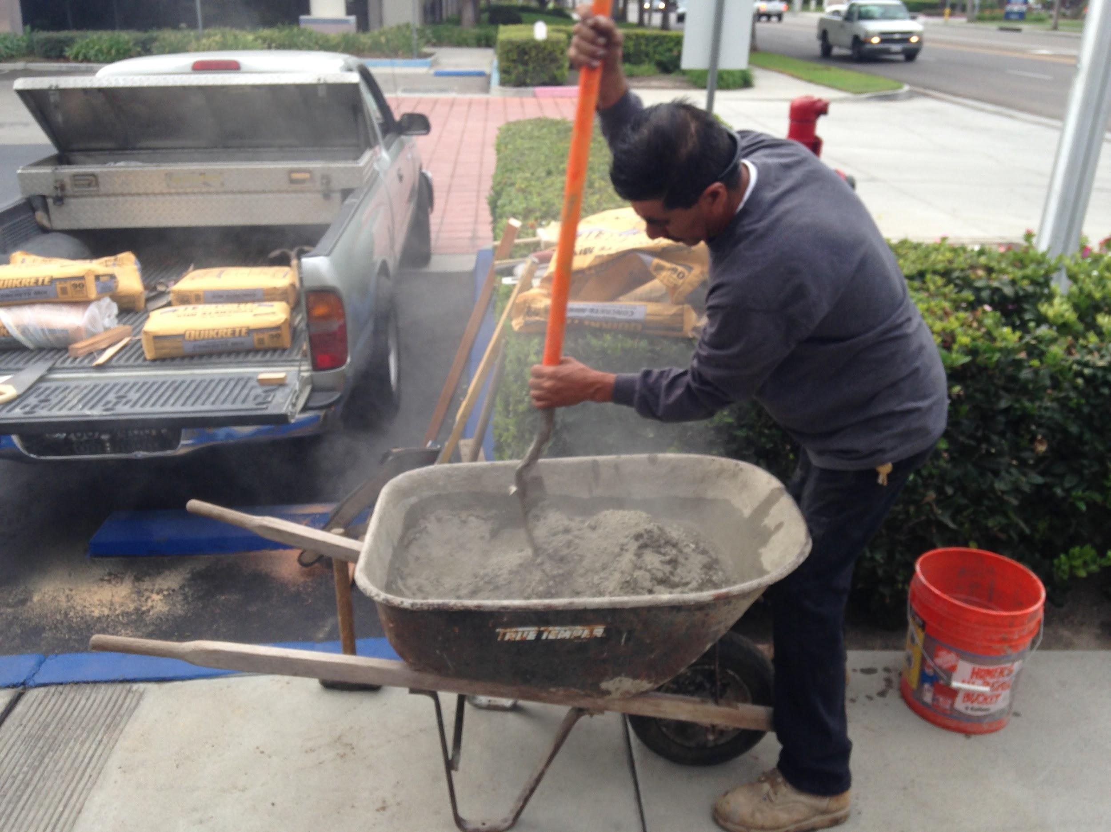
MIX Cement

Slide 7
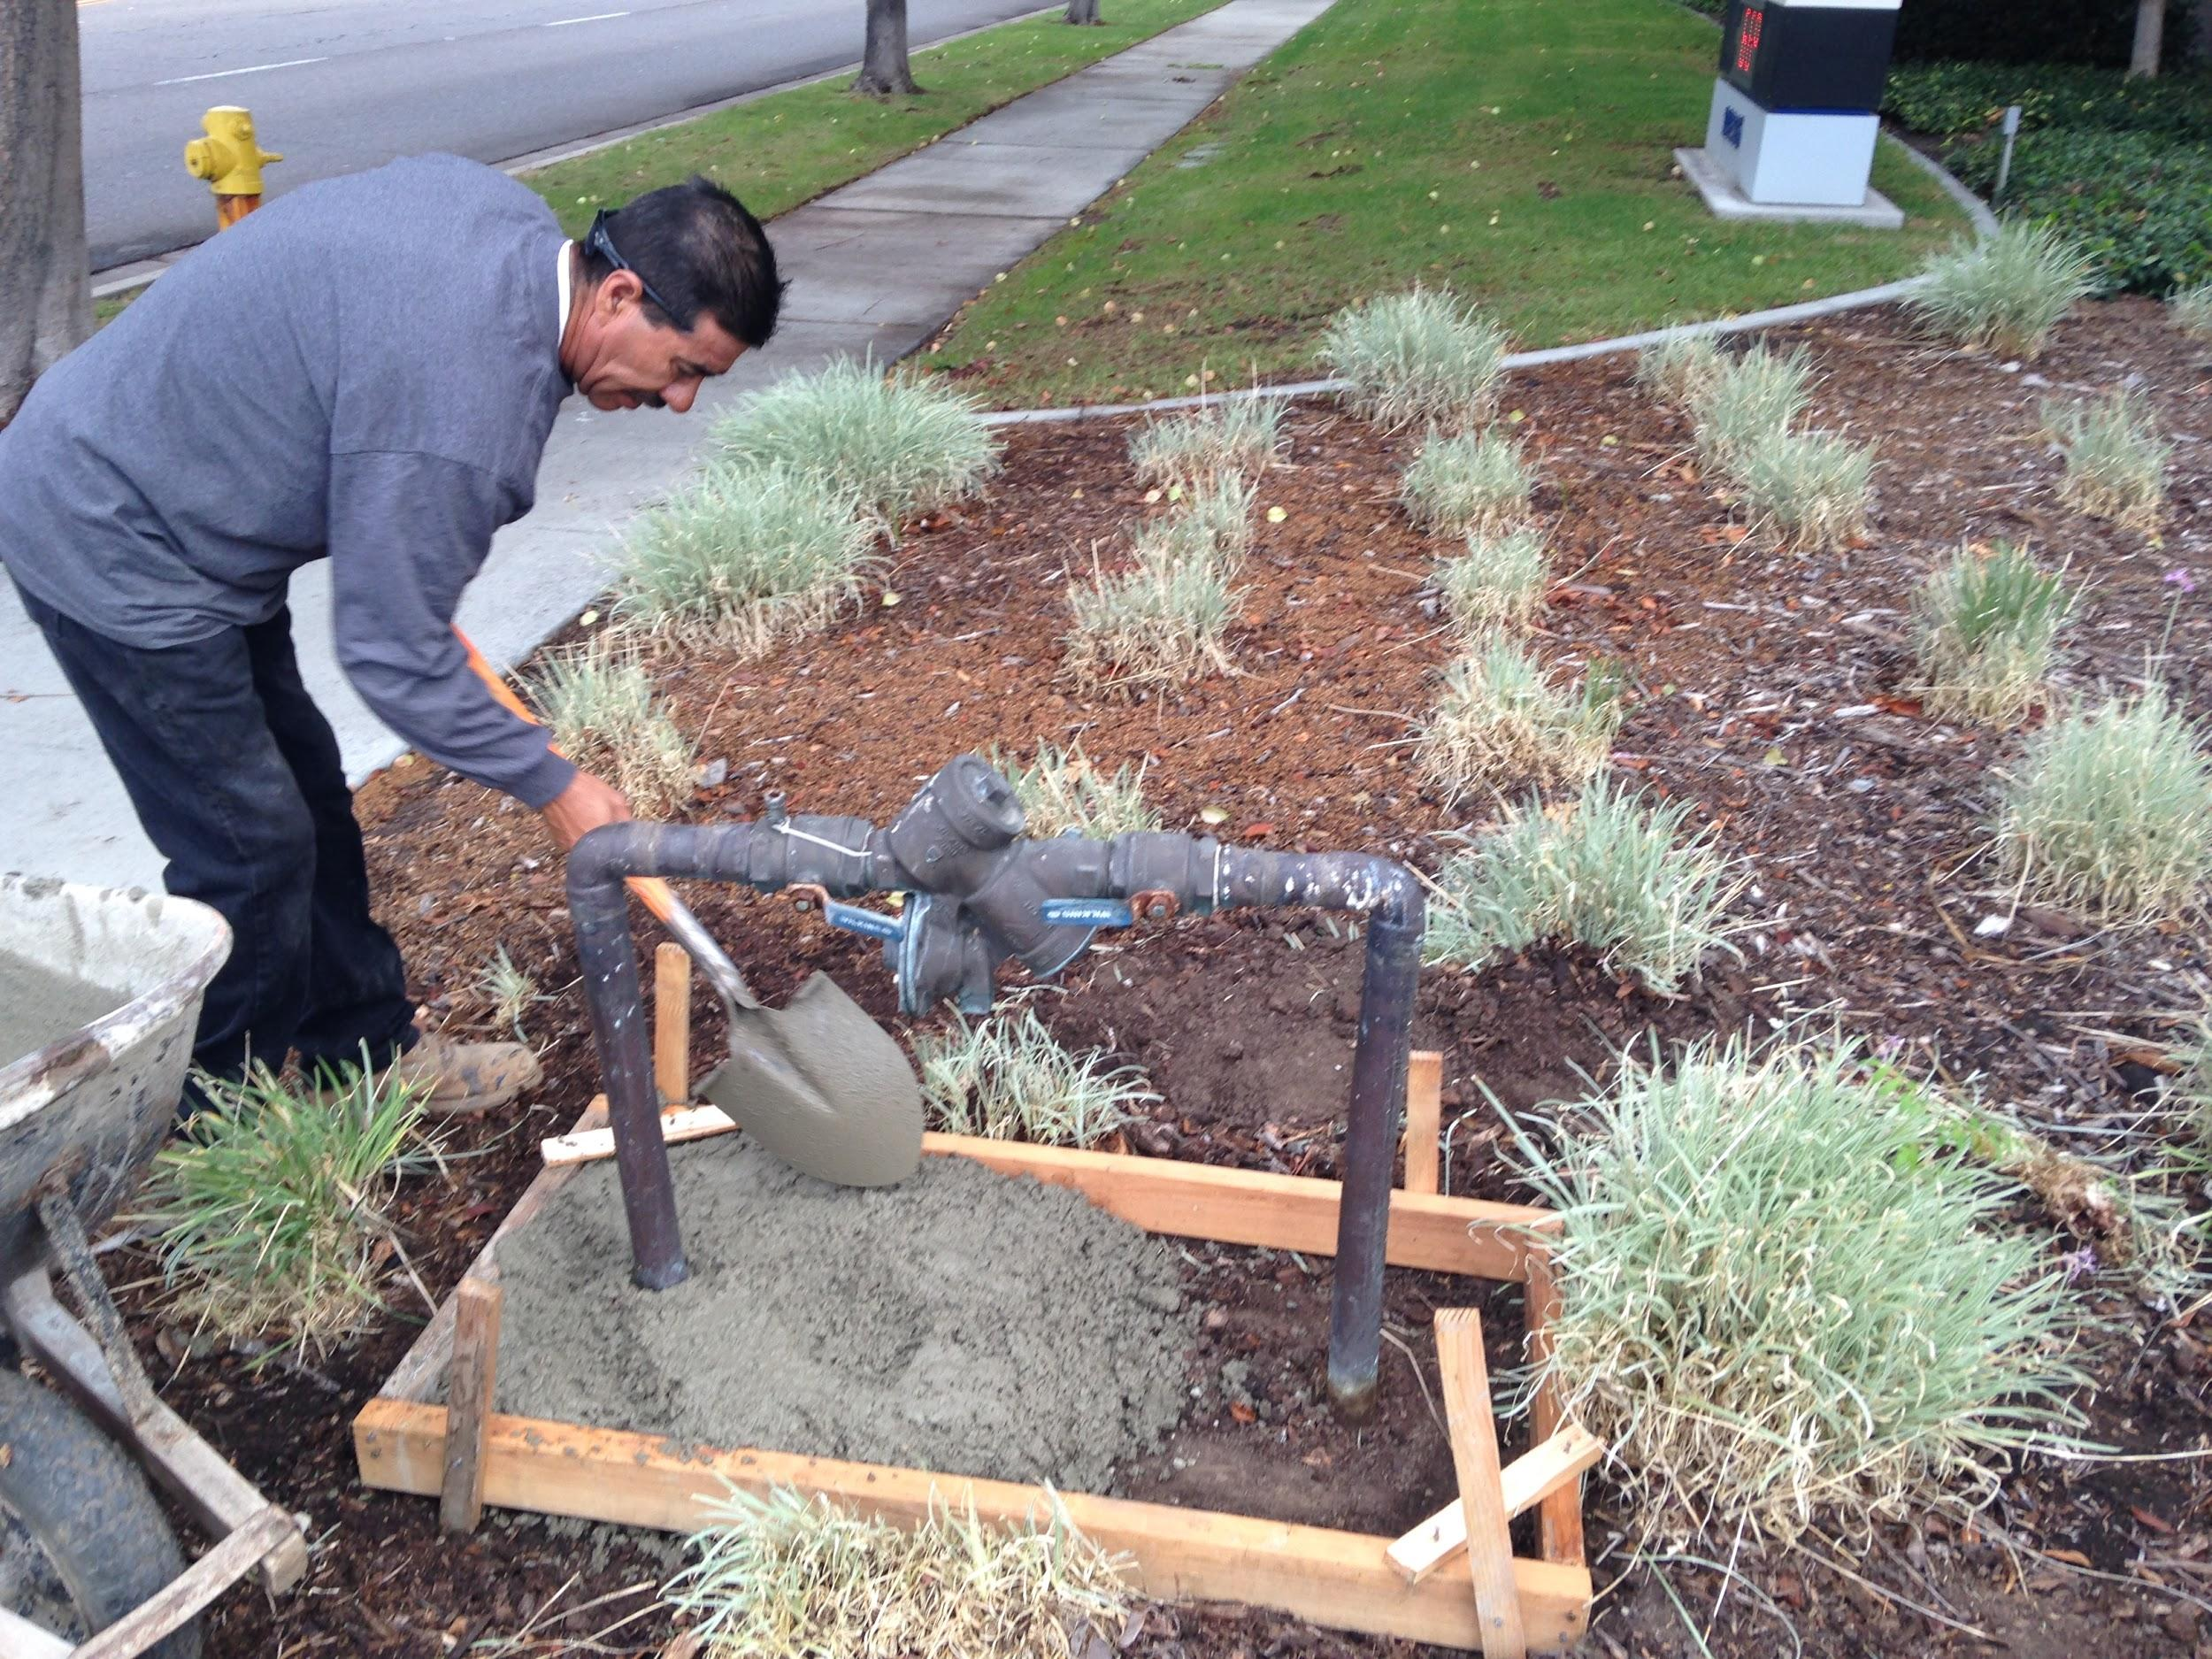
Pour Cement in Form

Slide 8
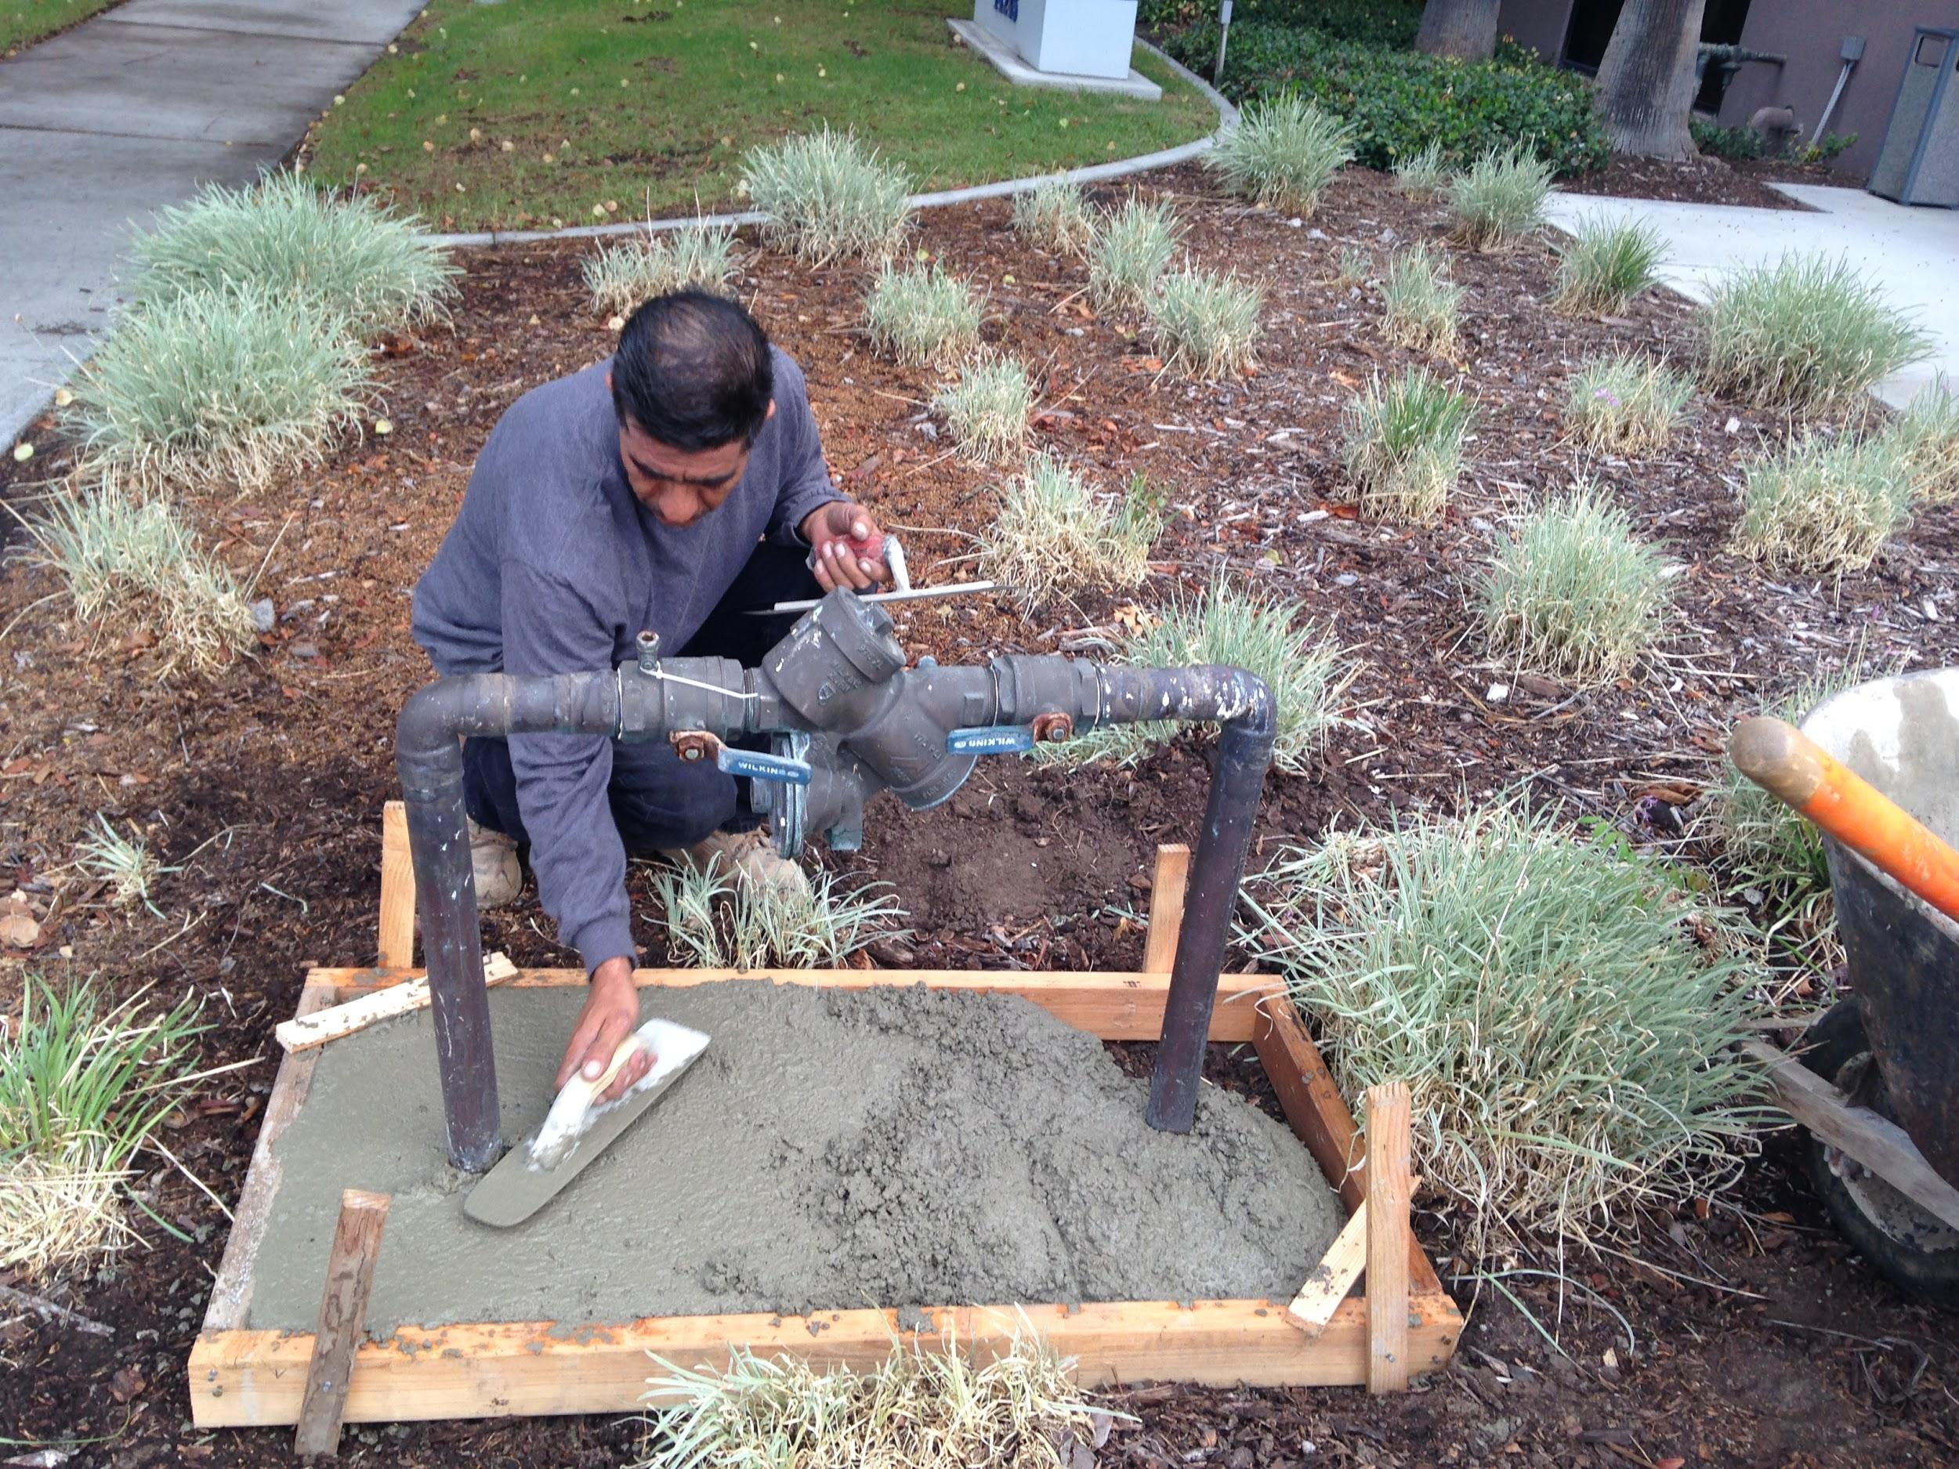
Chop and Smooth Cement into Form

Slide 9
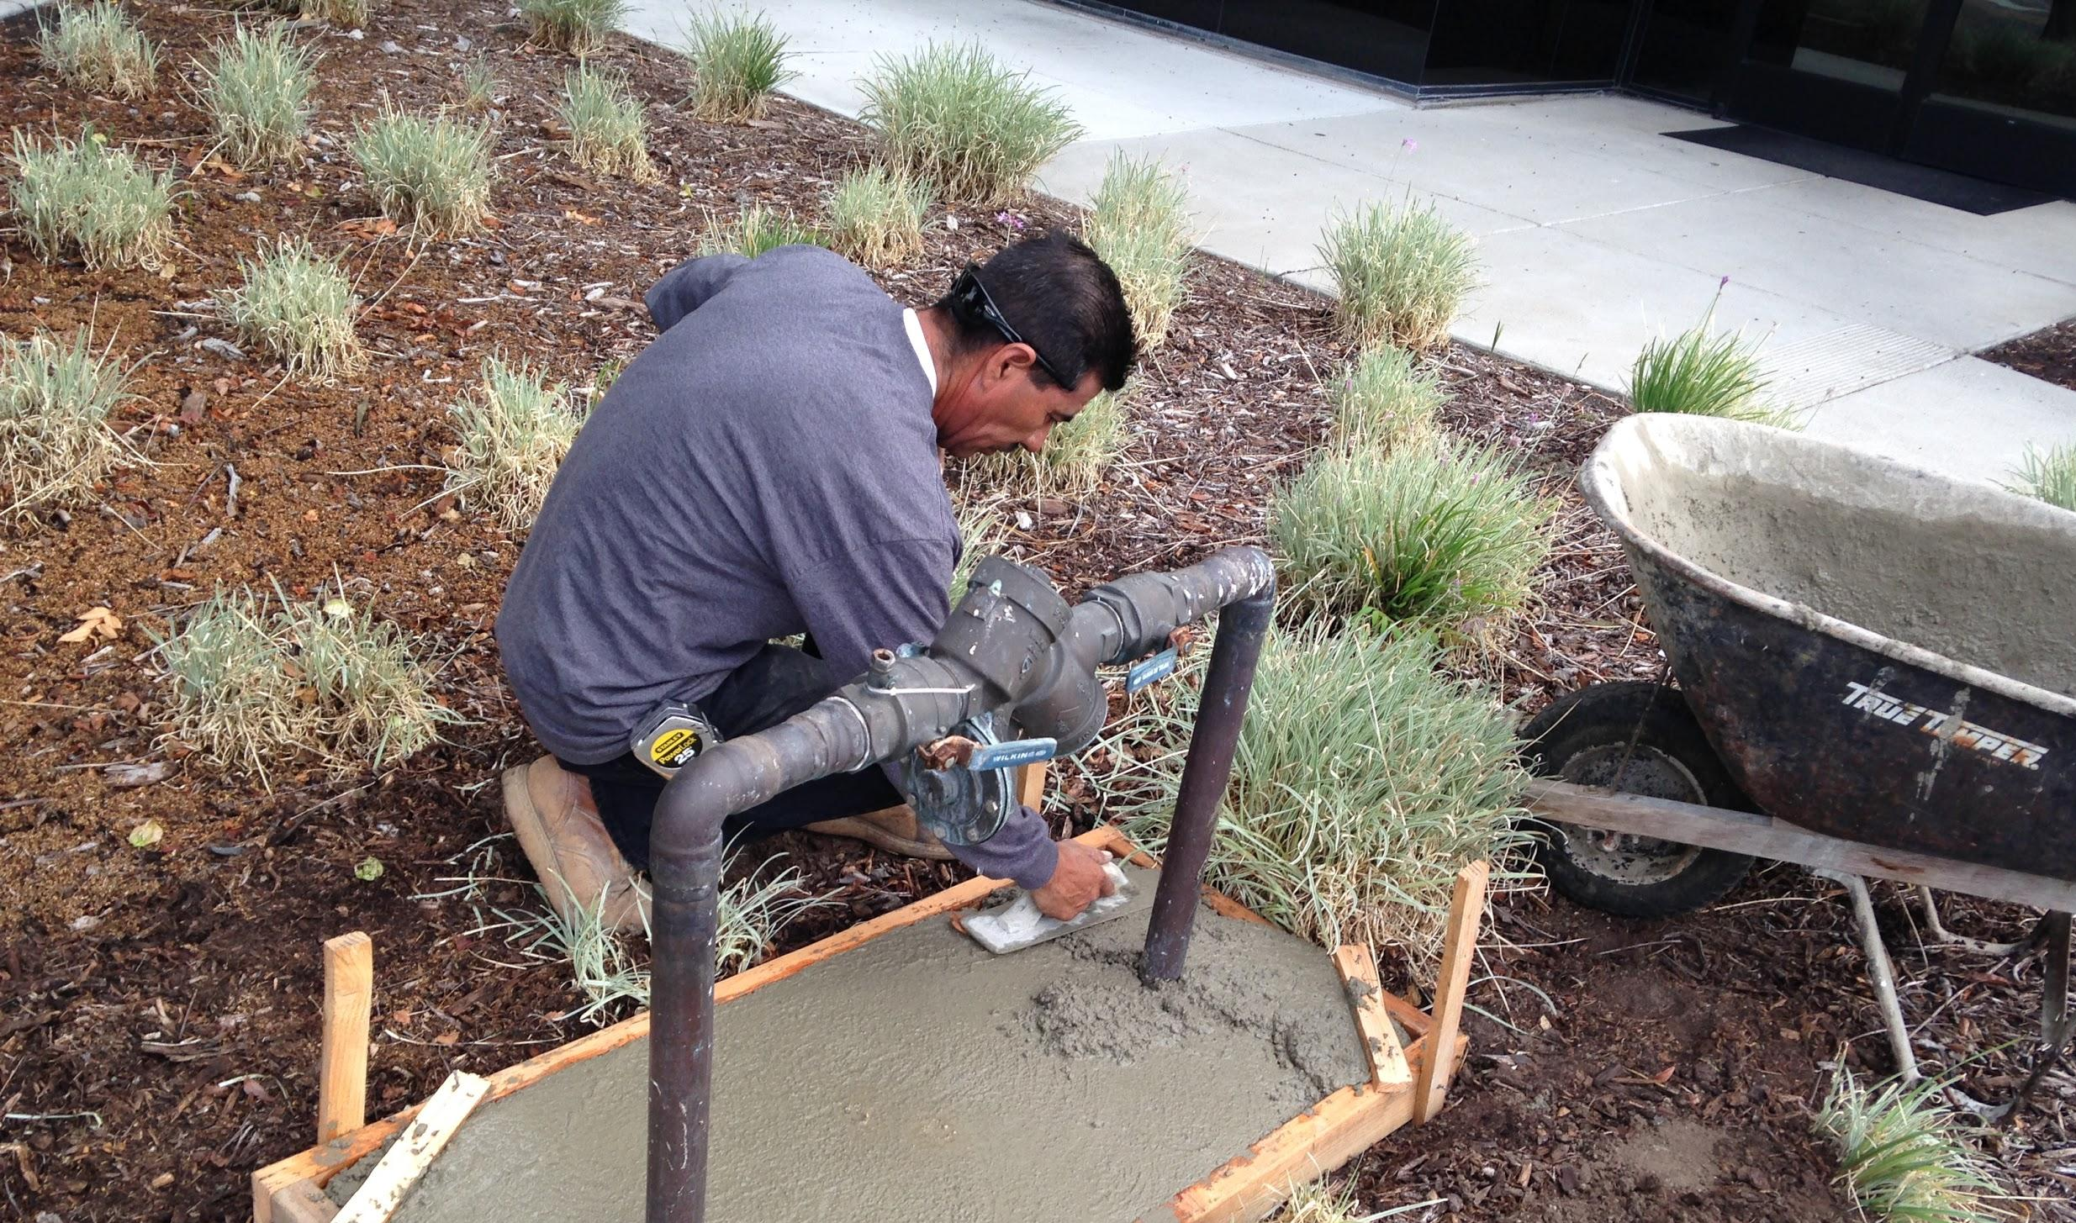
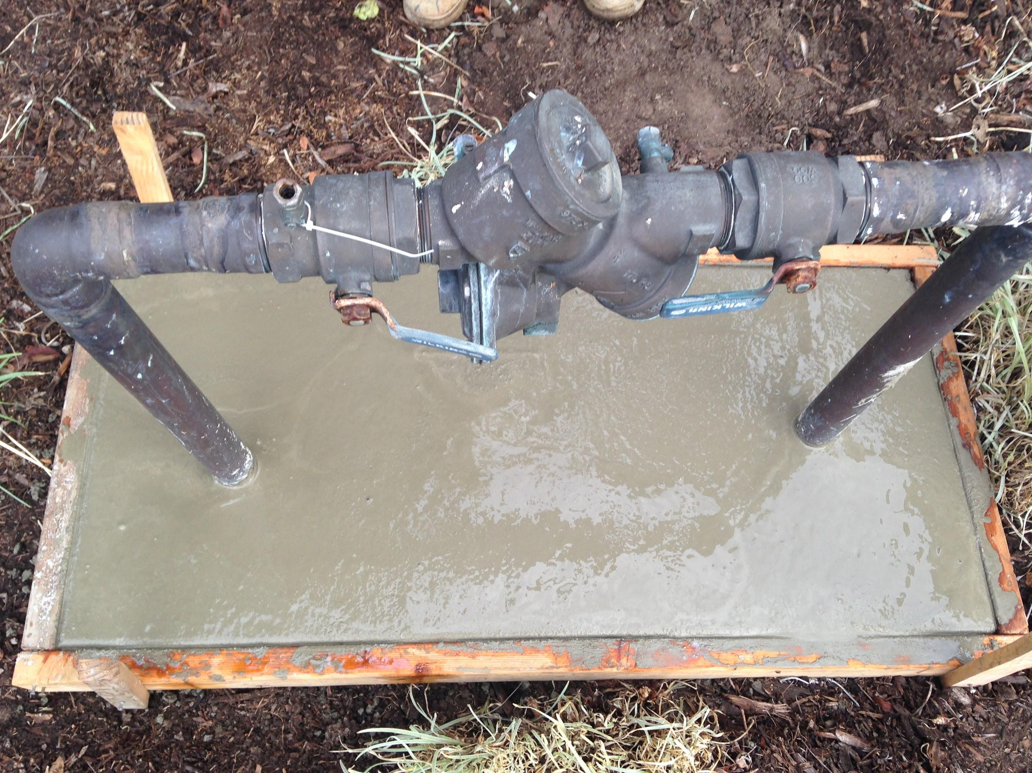
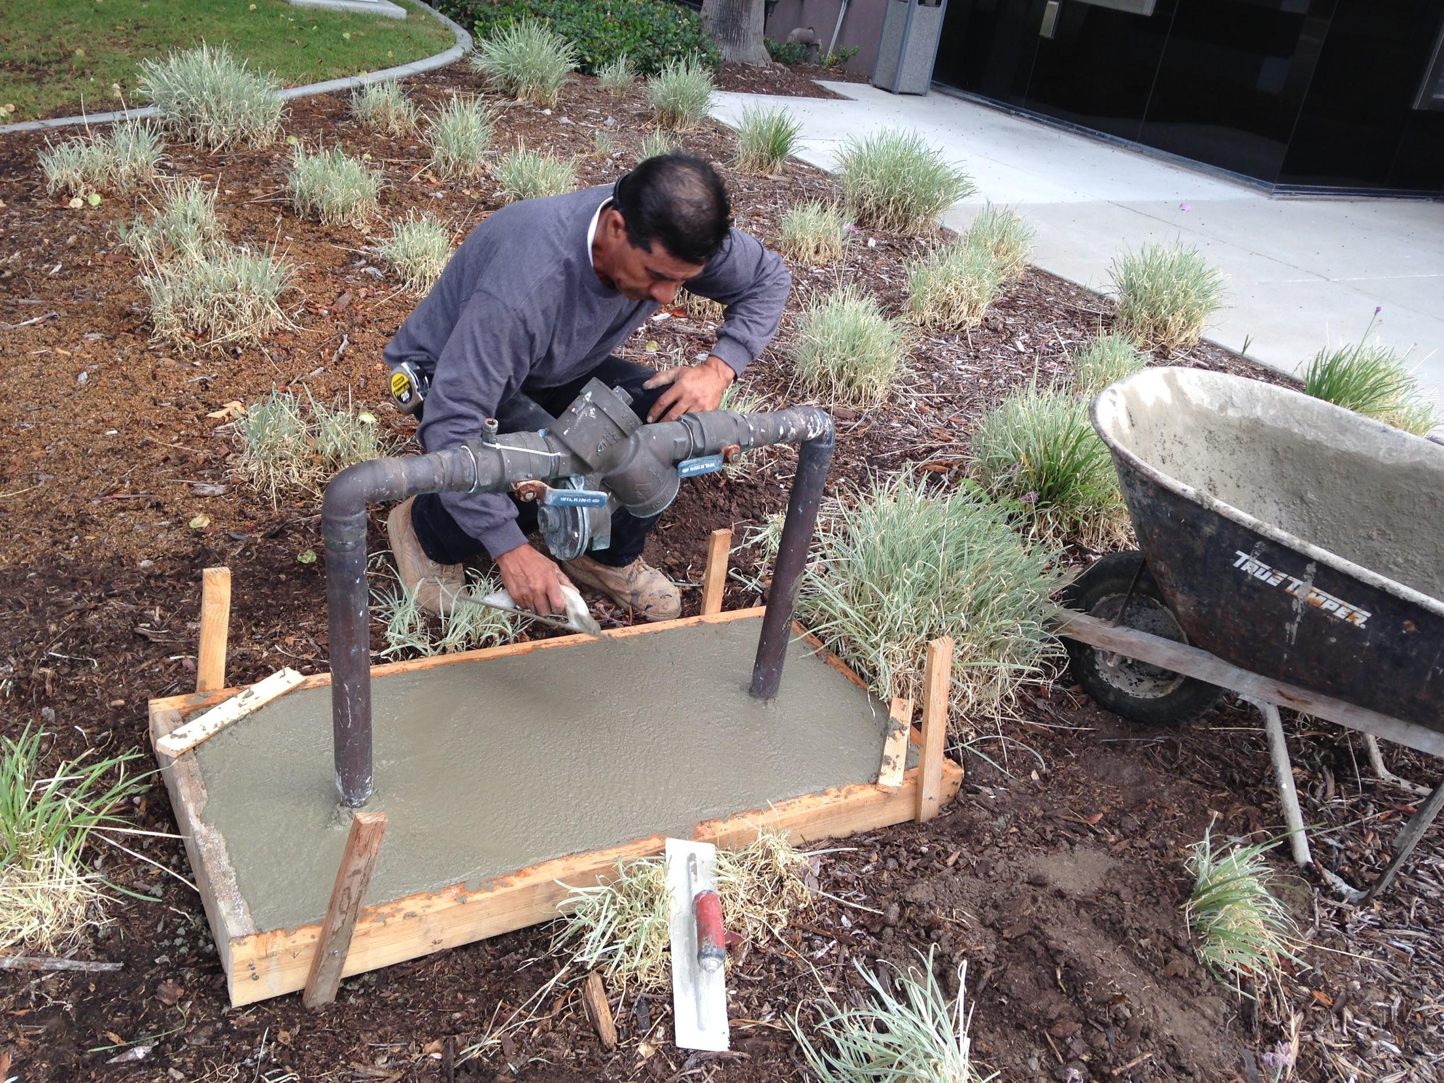
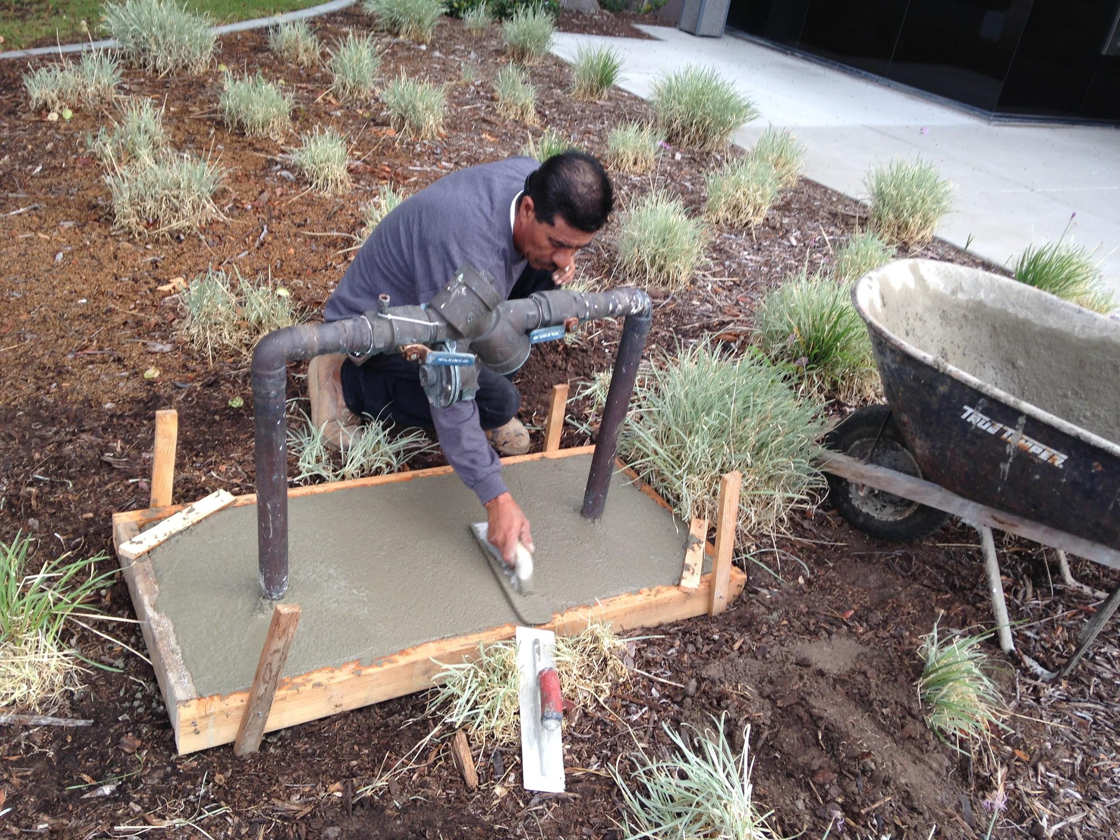
Edge the Cement
Edge And Smooth Concrete and let cure for pin placement.

Slide 10
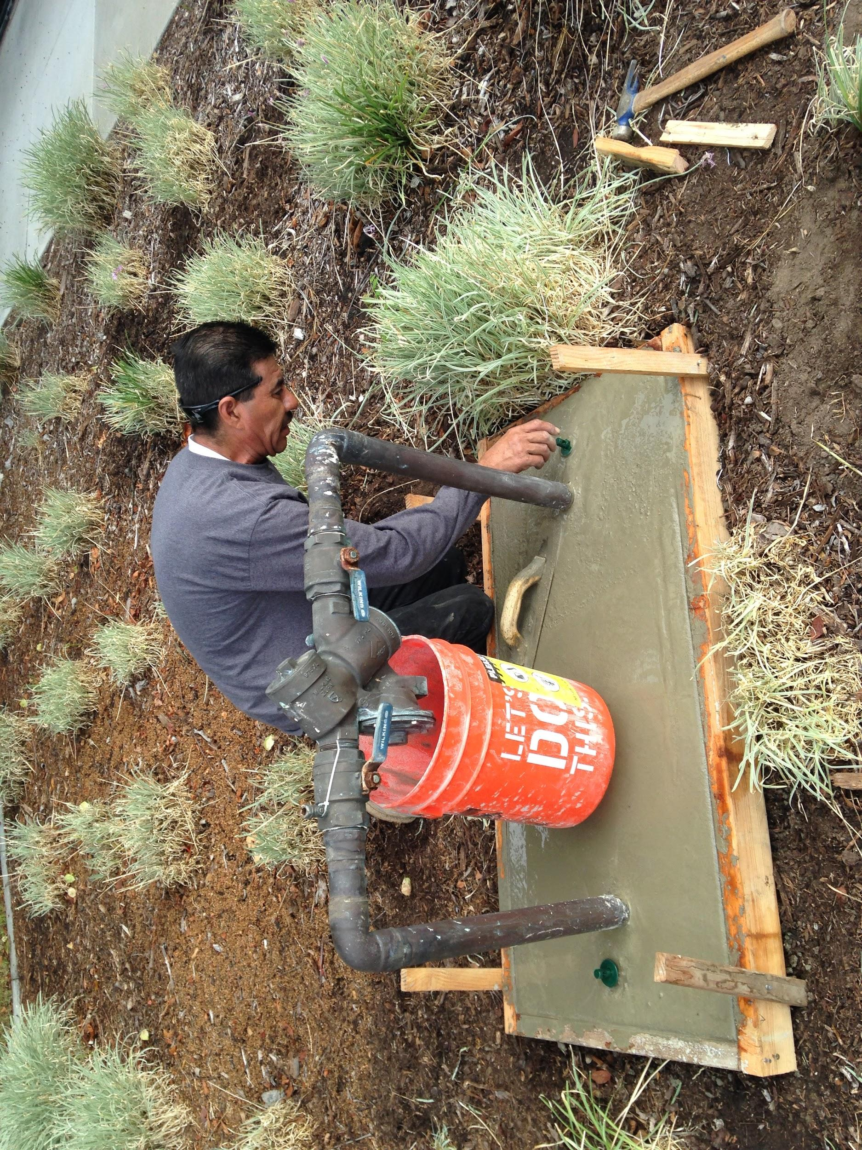
Measure Pin placement from Centerline to Centerline of hole and Place pins into cement.

Slide 11
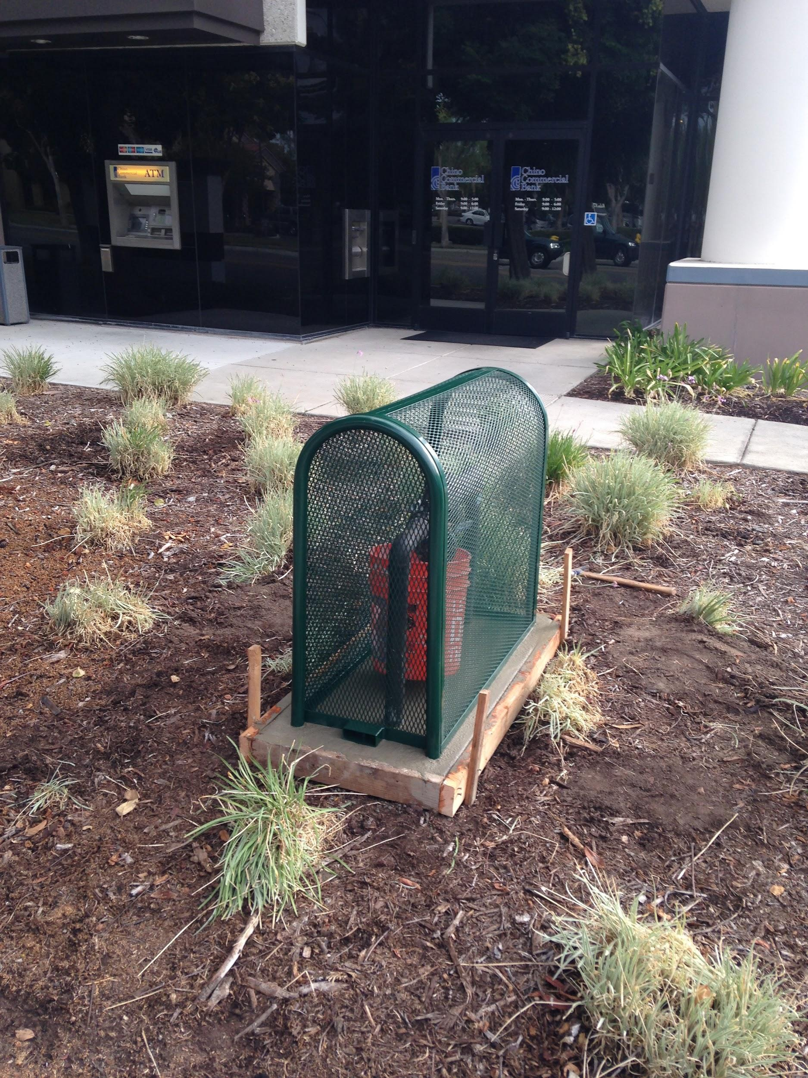
After placing the pins, let the cement harden. Keep forms on until completely dry.

Slide 12
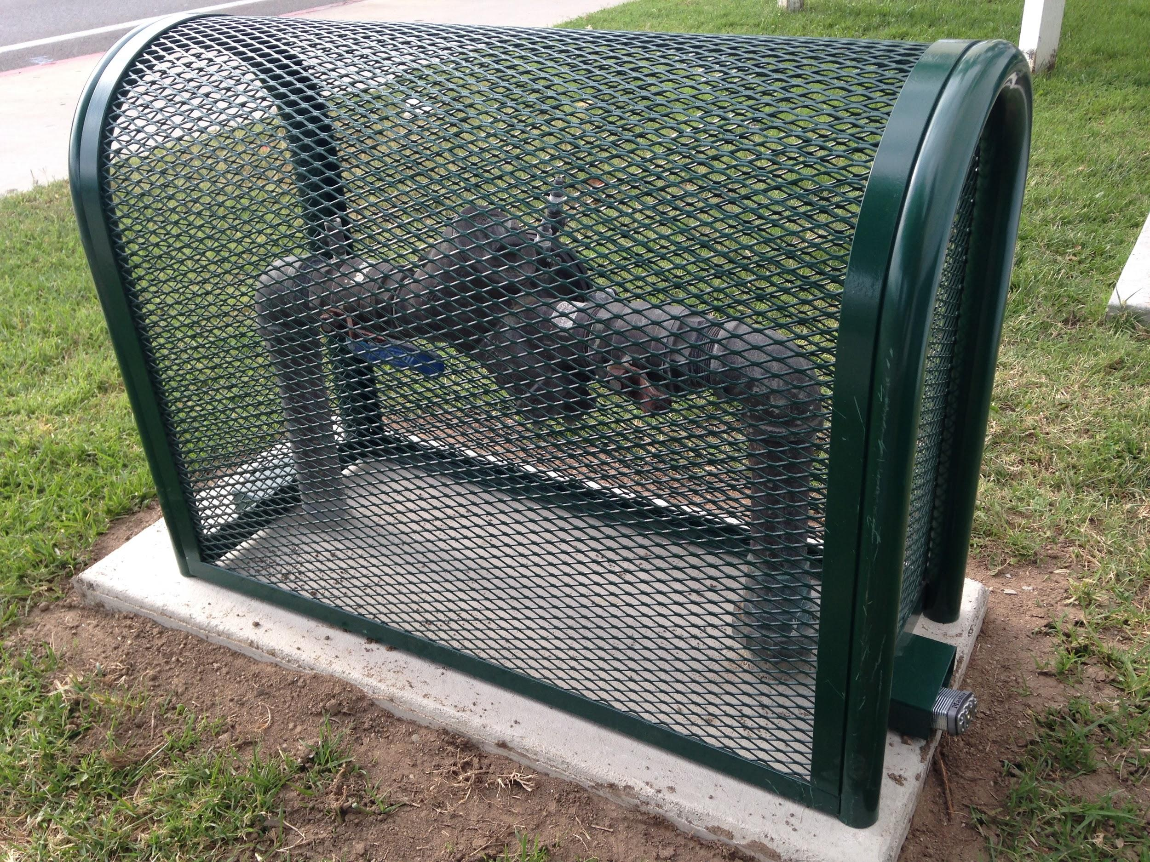
Place Cage on Pins and lock it up.

